Slide 1

Pharmacy Database Management System
5 Student Name: Mohamed Siddiq
Course: DPR400210 – Database ProgrammingInstructor:
Eric Maniraguha

Slide 2
_Introduction
Introduction
The Pharmacy Database Management System is designed to automate the daily operations of a pharmacy by efficiently managing medicines, suppliers, customers, and sales transactions.
The system was developed using Oracle Database with SQL and PL/SQL to ensure accurate data management, improved security, and better business performance.

Slide 3
_Problem Statement
Manual record keeping.
Problem Statement
Many pharmacies still rely on manual record-keeping, which often leads to:
Difficulty in managing medicine inventory.
Errors in sales recording.
Poor supplier and customer management.
Lack of accurate reports for decision-making.
Increased risk of data loss and inconsistency.
This project provides a computerized solution to overcome these challenges.
. .
.
.
.

Slide 4
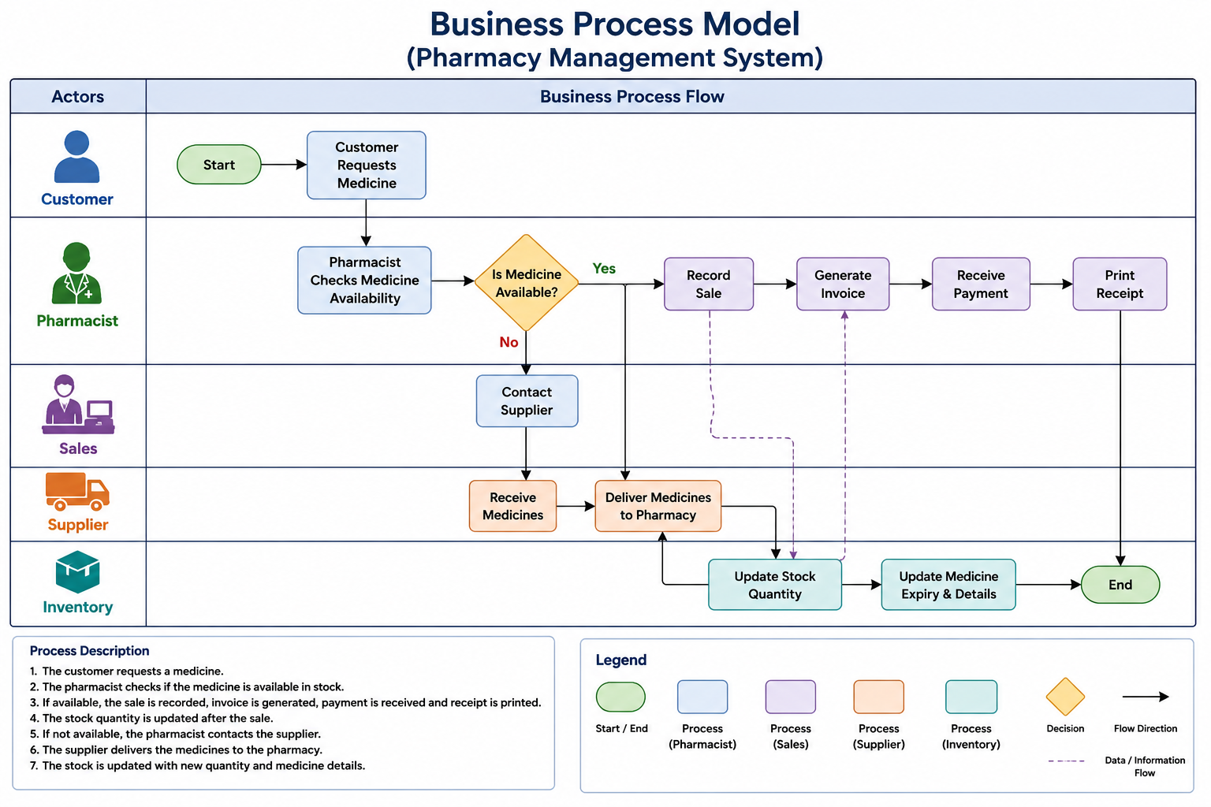
Objectives AND Business Process
Project Objectives
The main objectives of this project are:
Manage medicine information efficiently.
Store supplier and customer records.
Record and monitor sales transactions.
Maintain data integrity using database constraints.
Automate business operations using PL/SQL.
Improve database security through users, privileges, and auditing.

Slide 5
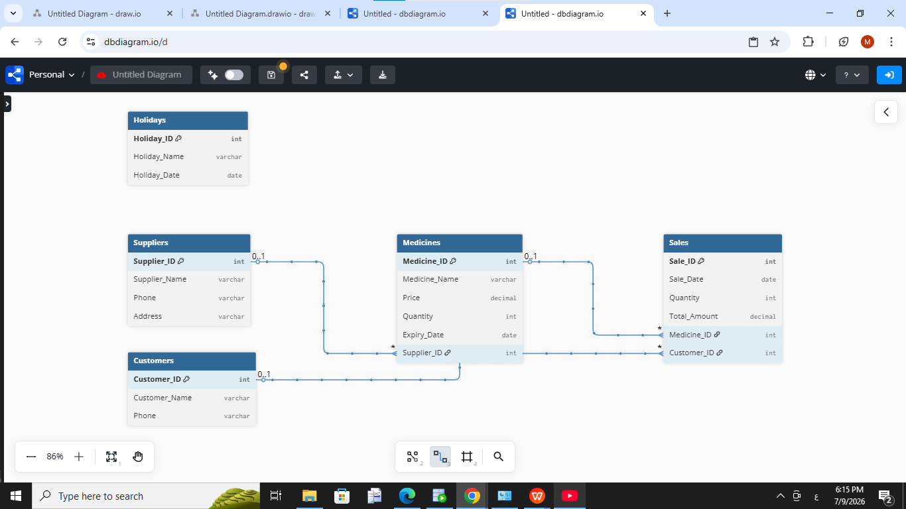
Database Design
Database Design
The database was designed using Entity Relationship Diagram (ERD) and normalized to Third Normal Form (3NF).
The system consists of five main entities:
Suppliers
Medicines
Customers
Sales
Holidays
Relationships between these entities ensure data consistency and eliminate redundancy.

Slide 6
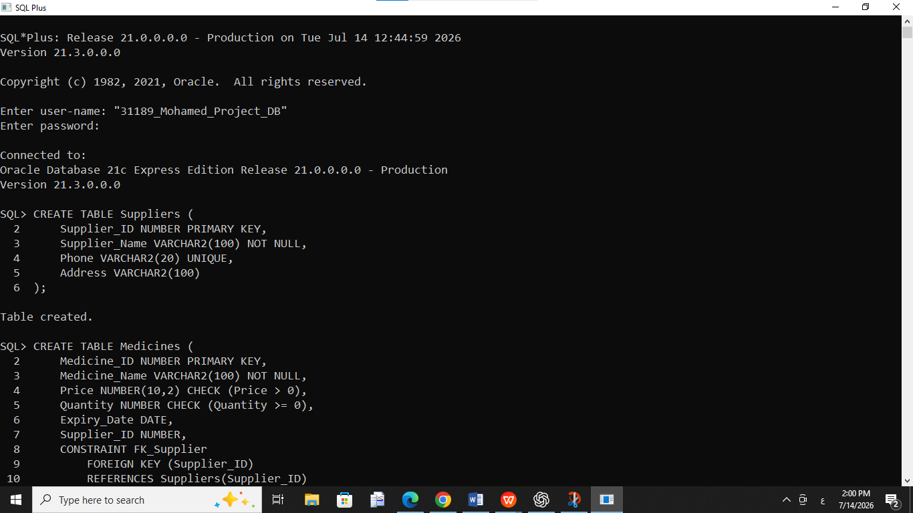
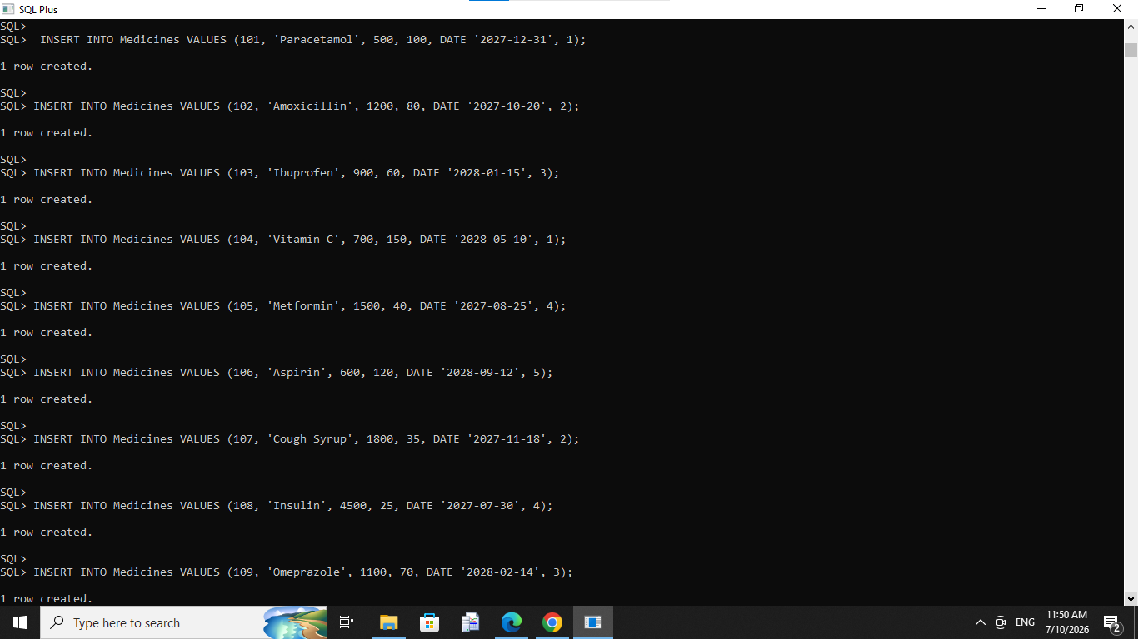
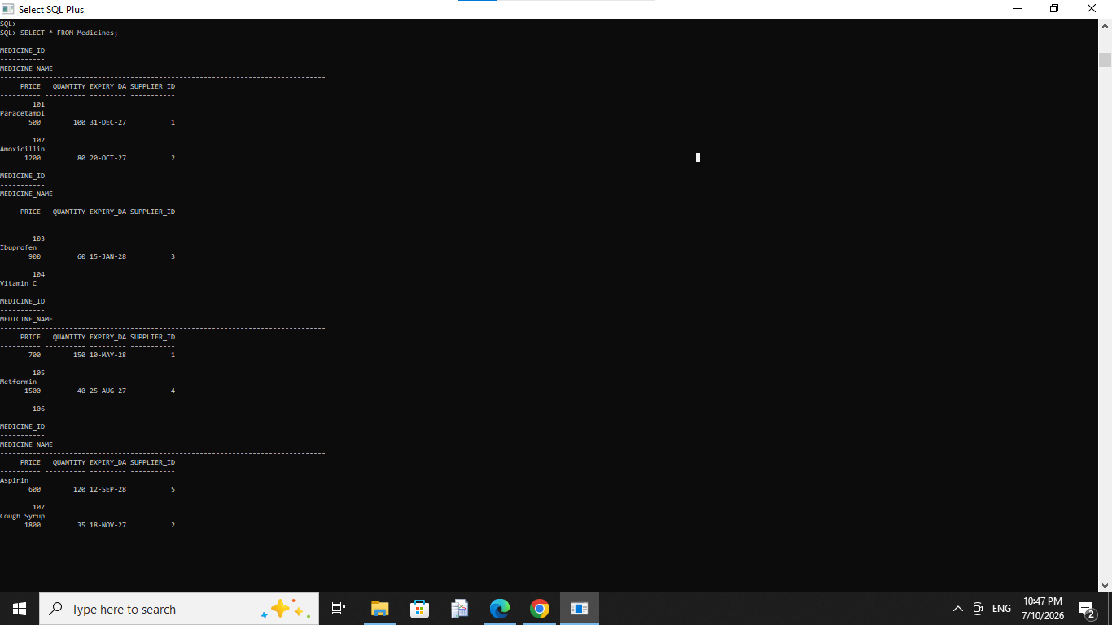
Database Implementation
Applying Constraints.
Inserting sample data.
Applying Constraints.
Inserting sample data.
Applying Constraints.
Inserting sample data.
Creating database tables.Defining Primary Keys and Foreign Keys.
1
2
3
…

Slide 7
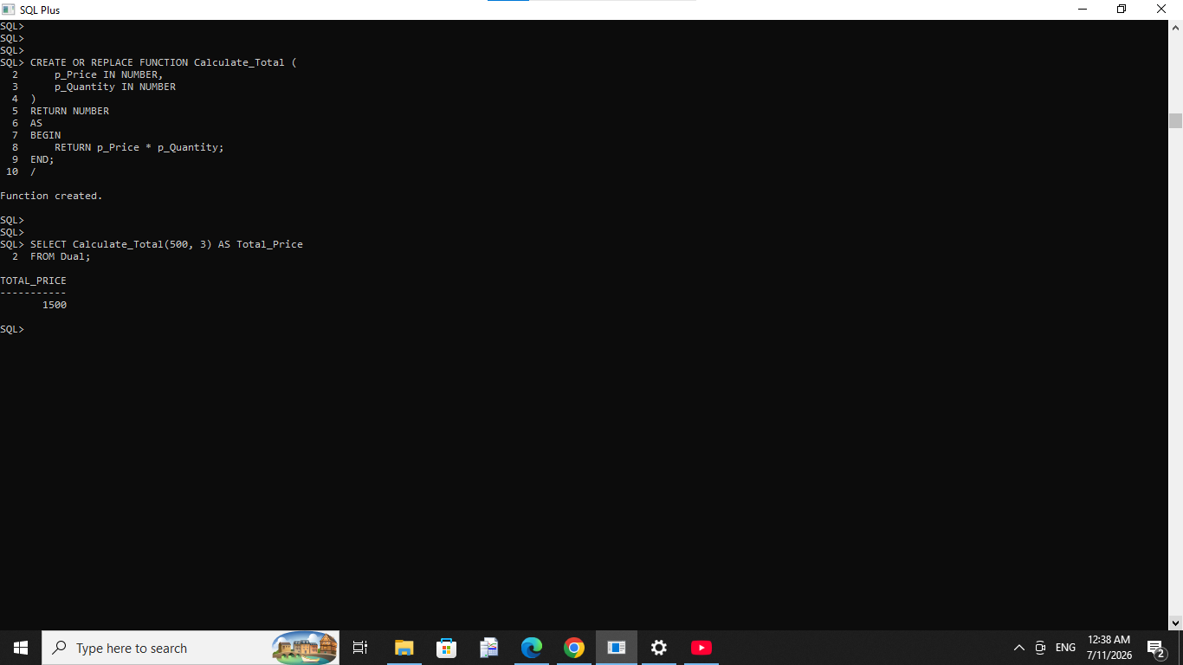


– PL/SQL Features
.
SELECT ME
PL/SQL Programming
Advanced Oracle features were implemented, including:
Stored Procedures
Functions
Packages
Triggers
Exception Handling
Transaction Control
These features automate business processes and improve system performance.

Slide 8
Results
Project Results
The developed system successfully:
Stores pharmacy information securely.
Tracks medicine stock levels.
Records customer purchases.
Generates accurate reports.
Enforces business rules using triggers.
Maintains data integrity throughout the database.

Slide 9
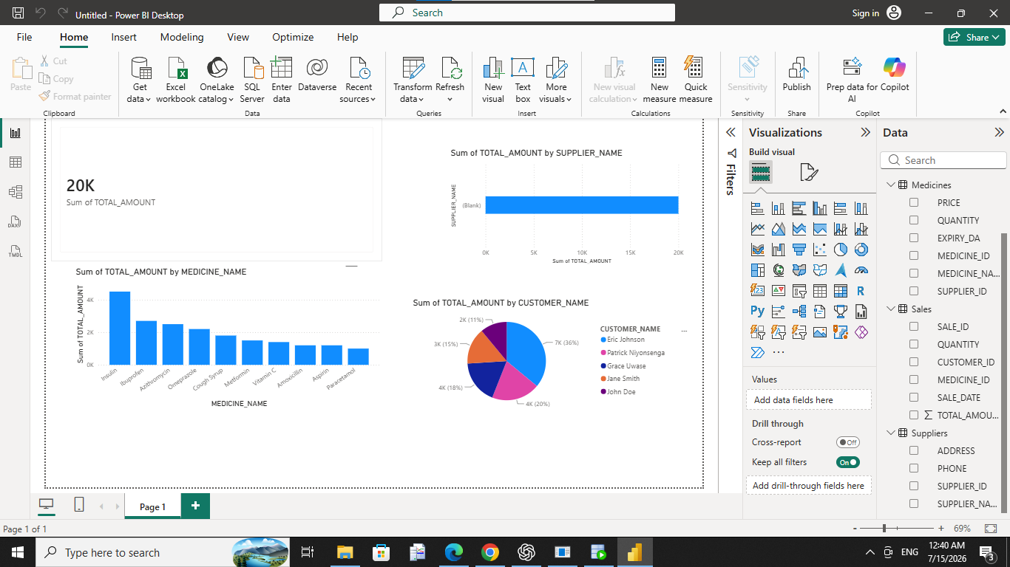
Innovation
. InnovationTo enhance the project, a Power BI Dashboard was developed to visualize pharmacy data.The dashboard provides:Total SalesAvailable MedicinesCustomer StatisticsSupplier StatisticsSales Performance ChartsThis helps managers make faster and more informed business decisions.
Notes:
In Slide Show mode, select the arrows to visit links.

Slide 10
Conclusion
Conclusion
The Pharmacy Database Management System demonstrates the practical use of Oracle SQL and PL/SQL in solving real-world business problems.
The project improves data accuracy, security, and operational efficiency while providing a scalable solution that can be expanded into a complete web or mobile application in the future.
Thank You

